Slide 1
BACK TO THE BASICS
VIOLATION REPORTS
Interstate Commission for Juveniles
Notes:
CORRIE
Welcome to the third session of the ICJ Wednesday Workshop Series!
My name is Corrie Copeland and I am the Commissioner for the state of Tennessee as well as the chair of the Commission's Training, Education, and Public Relations Committee.
We're so glad that you took the time out of your day to join us.
Without further ado, I'll turn the mic over to today's trainers: Jessica Wald, North Dakota Designee/Deputy Compact Administrator, Raymundo Gallardo, Utah Designee/Deputy Compact Administrator, and Nordia Napier, Connecticut Designee/Deputy Compact Administrator.

Slide 2
TODAY'S AGENDA
1 | Everything you need to know about Violation Reports
2 | Q&A Session (If time permits)
3 | UNITY Demonstration
Notes:
JESSICA
Hello and Welcome!
Today's Wednesday Workshop will cover everything you need to know about violation reports including the ICJ Rules and how to apply them.
Next, we'll have a Q&A session.
And finally, we'll do a UNITY Demonstration so that you can see what this task looks like in the system.
Finally, we'll hold a Q&A session.
To receive a certificate of completion for this training, you'll need to complete the training feedback survey.
As some of you may not be UNITY users, you're welcome to leave before we transition into that section.
We'll put the link to the survey in the chat box before you go, so that you can receive credit!

Slide 3
FOR A MORE IN-DEPTH LEARNING EXPERIENCE:
ENROLL IN THE "ICJ IN ACTION" LMS COURSES
REPORTING VIOLATIONS
(ICJ-102)
Notes:
JESSICA
For a more in-depth learning experience, enroll in the "ICJ in Action" LMS courses.

Slide 4
THE ICJ RULES | Note: A complete listing of all ICJ Rules can be found on the Commission's website.
 | Rule 5-103: Reporting Juvenile Non-Compliance, Failed Supervision and Retaking
Notes:
JESSICA
Today we will review Rule 5-103, Reporting Juvenile Non-Compliance, Failed Supervision and Retaking.

Slide 5
RULE 5-103(1) | Reporting Juvenile Non-Compliance, Failed Supervision and Retaking
At any time during supervision if a juvenile is out of compliance with conditions of supervision, the receiving state shall notify the sending state using Form IX Quarterly Progress, Violation or Absconder Report, which shall contain:
Notes:
JESSICA
Rule 5-103 paragraph 1 states:
At any time during supervision if a juvenile is out of compliance with conditions of supervision, the receiving state shall notify the sending state using Form IX Quarterly Progress, Violation or Absconder Report, which shall contain:
a. the date of the new citation or technical violation that forms the basis of the violation;
b. description of the new citation or technical violation;
c. status and disposition, if any;
d. supporting documentation regarding the violation including but not limited to police reports, drug testing results, or any other document to support the violation.
e. description of efforts made to redirect the behavior, including therapeutic interventions, incentives and/or graduated sanctions, or other corrective actions consistent with supervision standards in the receiving state; and;
f. receiving state recommendations.

Slide 6
RULE 5-103(1)
a | the date of the new citation or technical violation that forms the basis of the violation;
b | description of the new citation or technical violation;
c | status and disposition, if any;
d | supporting documentation regarding the violation including but not limited to police reports, drug testing results, or any other document to support the violation.
e | description of efforts made to redirect the behavior, including therapeutic interventions, incentives and/or graduated sanctions, or other corrective actions consistent with supervision standards in the receiving state; and;
f | receiving state recommendations.
Notes:
JESSICA
a. the date of the new citation or technical violation that forms the basis of the violation;
b. description of the new citation or technical violation;
c. status and disposition, if any;
d. supporting documentation regarding the violation including but not limited to police reports, drug testing results, or any other document to support the violation.
e. description of efforts made to redirect the behavior, including therapeutic interventions, incentives and/or graduated sanctions, or other corrective actions consistent with supervision standards in the receiving state; and;
f. receiving state recommendations.

Slide 7
RULE 5-103(2) | Reporting Juvenile Non-Compliance, Failed Supervision and Retaking
The sending state shall respond to a violation report in which a revocation or discharge is recommended by the receiving state no later than ten (10) business days following receipt by the sending state. The response shall include the action to be taken by the sending state, which may include continue supervision, and the date that action will occur.
Notes:
JESSICA
Rule 5-103 paragraph 2 states:
The sending state shall respond to a violation report in which a revocation or discharge is recommended by the receiving state no later than ten (10) business days following receipt by the sending state. The response shall include the action to be taken by the sending state, which may include continue supervision, and the date that action will occur.

Slide 8
RULE 5-103(3) | Reporting Juvenile Non-Compliance, Failed Supervision and Retaking
The decision of the sending state to retake a juvenile shall be conclusive and not reviewable within the receiving state. If the sending state determines the violation requires retaking or retaking is mandatory, the following shall be considered:
Notes:
JESSICA
Rule 5-103 paragraph 3 states:
The decision of the sending state to retake a juvenile shall be conclusive and not reviewable within the receiving state. If the sending state determines the violation requires retaking or retaking is mandatory, the following shall be considered:

Slide 9
RULE 5-103(3)
a | In those cases where the juvenile is suspected of having committed a criminal offense or an act of juvenile delinquency in the receiving state, the juvenile shall not be retaken without the consent of the receiving state until discharged from prosecution, or other form of proceeding, imprisonment, detention, or supervision.
b | The Form VI Application for Services and Waiver has the appropriate signatures; no further court procedures will be required for the juvenile’s return.
c | A duly accredited officer of a sending state may enter a receiving state and apprehend and retake any such juvenile on probation or parole consistent with probable cause requirements, if any. If this is not practical, a warrant may be issued and the supervising state shall honor that warrant in full.
d | The sending state shall return the juvenile in a safe manner, pursuant to the ICJ Rules within five (5) business days. This time period may be extended up to an additional five (5) business days with the approval from both ICJ Offices.
Notes:
JESSICA
a. In those cases where the juvenile is suspected of having committed a criminal offense or an act of juvenile delinquency in the receiving state, the juvenile shall not be retaken without the consent of the receiving state until discharged from prosecution, or other form of proceeding, imprisonment, detention, or supervision.
b. The Form VI Application for Services and Waiver has the appropriate signatures; no further court procedures will be required for the juvenile’s return.
***Remind audience the importance of signing the ICJ Form VI during the TOS referral process when covering Retaking.***
c. A duly accredited officer of a sending state may enter a receiving state and apprehend and retake any such juvenile on probation or parole consistent with probable cause requirements, if any. If this is not practical, a warrant may be issued and the supervising state shall honor that warrant in full.
d. The sending state shall return the juvenile in a safe manner, pursuant to the ICJ Rules within five (5) business days. This time period may be extended up to an additional five (5) business days with the approval from both ICJ Offices.

Slide 10
RULE 5-103(4) | Reporting Juvenile Non-Compliance, Failed Supervision and Retaking
Upon request from the receiving state, the sending state’s ICJ Office shall return the juvenile within five (5) business days in accordance with these rules when:
Notes:
JESSICA
Rule 5-103 paragraph 4 states:
Upon request from the receiving state, the sending state’s ICJ Office shall return the juvenile within five (5) business days in accordance with these rules when:
a. A legal guardian remains in the sending state and the supervision in the receiving state fails as evidenced by:
i. When a juvenile is no longer residing in the residence approved by the receiving state due to documented instances of violation of conditions of supervision; or
ii. When an alternative residence is determined to be in the best interest of the juvenile due to documented instances of violation of conditions of supervision and no viable alternatives exist in the receiving state; or
iii. When an immediate, serious threat to the health and safety of the juvenile and/or others in the residence or community is identified; and
iv. The receiving state has documented efforts or interventions to redirect the behavior.
b. The juvenile is not residing with a legal guardian and that person requests the juvenile be removed from his/her home. The sending state shall secure alternative living arrangements within five (5) business days or the juvenile shall be returned. This time period may be extended up to an additional five (5) business days with the approval from both ICJ Offices.
c. A juvenile student or juvenile who resides independently in the receiving state whose transfer of supervision fails.

Slide 11
RULE 5-103(4)
a | A legal guardian remains in the sending state and the supervision in the receiving state fails as evidenced by:
 | i. When a juvenile is no longer residing in the residence approved by the receiving state due to documented instances of violation of conditions of supervision; or
 | ii. When an alternative residence is determined to be in the best interest of the juvenile due to documented instances of violation of conditions of supervision and no viable alternatives exist in the receiving state; or
 | iii. When an immediate, serious threat to the health and safety of the juvenile and/or others in the residence or community is identified; and
 | iv. The receiving state has documented efforts or interventions to redirect the behavior.
Notes:
JESSICA
a. A legal guardian remains in the sending state and the supervision in the receiving state fails as evidenced by:
i. When a juvenile is no longer residing in the residence approved by the receiving state due to documented instances of violation of conditions of supervision; or
ii. When an alternative residence is determined to be in the best interest of the juvenile due to documented instances of violation of conditions of supervision and no viable alternatives exist in the receiving state; or
iii. When an immediate, serious threat to the health and safety of the juvenile and/or others in the residence or community is identified; and
iv. The receiving state has documented efforts or interventions to redirect the behavior.
b. The juvenile is not residing with a legal guardian and that person requests the juvenile be removed from his/her home. The sending state shall secure alternative living arrangements within five (5) business days or the juvenile shall be returned. This time period may be extended up to an additional five (5) business days with the approval from both ICJ Offices.
c. A juvenile student or juvenile who resides independently in the receiving state whose transfer of supervision fails.

Slide 12
RULE 5-103(4)
b | The juvenile is not residing with a legal guardian and that person requests the juvenile be removed from his/her home. The sending state shall secure alternative living arrangements within five (5) business days or the juvenile shall be returned. This time period may be extended up to an additional five (5) business days with the approval from both ICJ Offices.
c | A juvenile student or juvenile who resides independently in the receiving state whose transfer of supervision fails.
Notes:
b. The juvenile is not residing with a legal guardian and that person requests the juvenile be removed from his/her home. The sending state shall secure alternative living arrangements within five (5) business days or the juvenile shall be returned. This time period may be extended up to an additional five (5) business days with the approval from both ICJ Offices.
c. A juvenile student or juvenile who resides independently in the receiving state whose transfer of supervision fails.

Slide 13
VIOLATION REPORT
A violation report is used to notify the sending state when a juvenile is out of compliance with their conditions of supervision.
Violation reports are completed using the ICJ Form IX.
Notes:
RAYMUNDO
A violation report is used to notify the sending state when a juvenile is out of compliance with their conditions of supervision.
Violation reports are completed on Form IX, much like Quarterly Progress Reports.
Violation Reports will need to be detailed and contain specific information in order for the sending state to respond appropriately to the violation.
If a juvenile is out of compliance at any time during supervision, the receiving state shall notify the sending state within an expedient timeframe.
In the spirit of the “golden rule,” report to others what you would want reported to yourself.
***Reach out to your state Compact Office for specific timelines and operating procedures***

Slide 14
WHAT SHOULD BE INCLUDED?
Date | Description | Status and Disposition (if any)
Supporting Documentation | Description of efforts made to redirect behavior (Including therapeutic interventions and/or graduated sanctions or other corrective actions) | Receiving State Recommendations
Notes:
RAYMUNDO
The following information must be included when completing a violation report:
-the date of the new citation or technical violation that forms the basis of the violation;
-description of the new citation or technical violation;
-status and disposition, if any;
-supporting documentation regarding the violation including but not limited to police reports, drug testing results, or any other document to support the violation;
-description of efforts made to redirect the behavior, including therapeutic interventions, incentives and/or graduated sanctions, or other corrective actions consistent with supervision standards in the receiving state; and;
-receiving state recommendations.

Slide 15
Reporting New Citations or Technical Violations
 | How has/will this behavior impact the supervision of this juvenile?
 | Does this behavior pose a safety risk to the juvenile or the public?
 | Has treatment, school, or home life been impacted by these behaviors?
Notes:
RAYMUNDO
When reporting a new citation or technical violation it is important to be very descriptive of the events that occurred.
The who, what, where, when and how are good points to consider when submitting a violation report.
How this behavior has or will impact the supervision of this juvenile?
Does this behavior pose a safety risk to the juvenile or the public?
Has treatment, school or home life been impacted by these behaviors?

Slide 16
PENDING CHARGES
1 | What are the new charges?
2 | When is the next court date?
3 | What was the outcome of the last court hearing?
Notes:
RAYMUNDO
If the juvenile has pending charges you will need to include the status of these charges and the disposition, if any.
-What are the new charges?
-When is the next court date?
-What was the outcome of the last court hearing?
The more information that can be provided the better. We always want to provide a full picture for the sending state.

Slide 17
SUPPORTING DOCUMENTATION
Police Reports | Court Documents | Community Service Documents | Treatment Documents
Educational Reports | School Disciplinary Reports | Letters or Documents Provided by the Guardian | Employer Updates or Status
Notes:
It is important that you include supporting documentation to go along with your recommendation on the violation report.
Examples of supporting documentation are:
-police reports,
-court documents,
-community service documents,
-treatment reports,
-educational reports,
-school disciplinary reports,
-letters or documents provided by the guardian,
-employer updates or status
A key thing to remember is the more supporting documents that can be provided the better. We also want to provide a clear and accurate representation of the juvenile’s compliance or lack thereof with the conditions of supervision.

Slide 18
OUT OF OPTIONS?
What sanctions have been imposed? What options remain in the receiving state to try to correct and redirect the juvenile's behavior?
Notes:
RAYMUNDO
Be sure to address in your report whether all options have been exhausted.
What sanctions have been imposed? Have you documented them? (Sanctions are different in every state)
What options remain in the receiving state to try to correct and redirect the juvenile’s behavior?
What have you done to try to correct the behavior without requesting revocation?

Slide 19
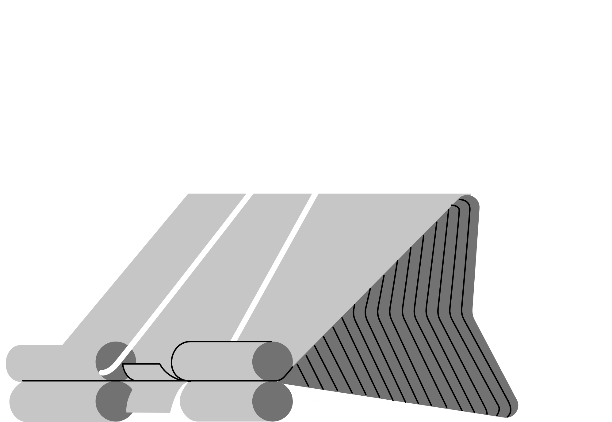
THE RECOMMENDATION
The final decision is up to the Sending State in compliance with the ICJ Rules.
Continue Supervision | Request Discharge | Request Revocation
Notes:
RAYMUNDO
Lastly, you will want to make a recommendation on the violation report.
There are three options to chose from:
-Continue supervision;
-Request discharge; or
-Request revocation.
***Explain what each means briefly
***Mention the importance of communicating with your ICJ Office (to agree on a recommendation).
Remember, your recommendations hold weight and can impact how the sending state will respond.
The Sending State ICJ office will make sure that the formal reply complies with ICJ Rules when request discharge or request revocation are checked.

Slide 20
Failed transfer? | *Within 5 business days
1 | The sending state shall secure alternate living arrangements in the receiving state OR
2 | The juvenile shall be returned to the sending state
Note: This time period may be extended up to an additional five business days with the approval from both ICJ Offices.
Notes:
RAYMUNDO
If the transfer fails, options include:
Within 5 business days, the sending state shall
secure alternative living arrangements in the receiving state, or
the juvenile shall be returned to the sending state
This time period may be extended up to an additional five business days with the approval from both ICJ Offices.

Slide 21
RETAKING
Retaking is the act of a sending state physically removing a juvenile, or causing to have a juvenile removed, from a receiving state.
The decision of the sending state to retake a juvenile shall be conclusive and not reviewable within the receiving state.
Notes:
RAYMUNDO
The decision of the sending state to retake a juvenile shall be conclusive and not reviewable within the receiving state.
If the sending state determines the violation requires retaking or retaking is mandatory, the following shall be considered:
A juvenile suspected of committing a new criminal offense or with pending charges is not available for retaking unless both states agree to the retaking, or the pending matters have been resolved.
Pursuant to the ICJ rules, a court hearing for return or retaking is not required when there is an appropriately signed Form VI in the file. However, such hearing can be important to ensure that juveniles due process rights are protected when the juvenile is at risk of having their probation or parole revoked.
The sending state shall return the juvenile in a safe manner, pursuant to the ICJ Rules, within five business days. This time period may be extended up to an additional five business days with the approval from both ICJ Offices.
Duly accredited officers may enter a receiving state and apprehend and retake a juvenile. If this is not practical, a warrant may be issued and the sending state shall honor that warrant in full.

Slide 22
1 | Juveniles cannot be retaken when there are pending charges, unless both states agree.
2 | All warrants issued for juveniles subject to the Compact shall be entered into NCIC with a nationwide pickup radius.
3 | The holding state shall not release the juvenile in custody on bond.
Things to remember when retaking or returning a juvenile:
Notes:
RAYMUNDO
Things to remember when retaking/returning a juvenile:
Juveniles cannot be retaken when there are pending charges unless both states agree.
All warrants issued for juveniles subject to the Compact shall be entered into the National Crime Information Center (NCIC) with a nationwide pickup radius and not eligible for bond.
The holding state shall not release the juvenile in custody on bond.
***Remind audience the importance of signing the ICJ Form VI during the TOS referral process when covering Retaking.
Again, refer to your state Compact Office for your state’s specific processes and timelines.

Slide 23
In many cases, the sending state must return the juvenile within five business days upon a request from the receiving state.
Rule 5-103 (4) describes 3 types of cases where returns are required upon the request of the receiving state.
Notes:
RAYMUNDO
In many cases, the sending state must return the juvenile within five business days upon a request from the receiving state. Rule 5-103(4) describes three types of cases where returns are required upon the request of the receiving state.

Slide 24
The juvenile must be returned within 5 business days when:
1 | Legal guardian remains in sending state + there is specific evidence of failed supervision
2 | Juvenile is not residing with the legal guardian + that person requests the juvenile be removed from the home
3 | Juvenile is a student or resides independently in the receiving state
Notes:
RAYMUNDO
The first type of case occurs when the legal guardian remains in the sending state and there is specific evidence of failed supervision.
Evidence of failed supervision in these cases, can be that the juvenile no longer resides in the residence approved by the receiving state or an alternative residence is determined to be in the best interest of the juvenile due to documented instances of violations of conditions or supervision.
Similarly, if the legal guardian remains in the sending state, the juvenile must be returned upon the request of the receiving state when there is an immediate, serious threat to the health and safety of the juvenile or others in the residence or community and the receiving state has documented efforts or interventions to redirect the behavior.
Juveniles must also be returned within 5 business days upon request of the receiving state when: The juvenile is not residing with the legal guardian and that person requests the juvenile be removed from the home. In such cases, the sending state has 5 business days to secure alternate living arrangements or return the juvenile. This period may be extended up to an additional 5 days.
Finally, a juvenile must be returned within 5 business days upon request from the receiving state if the juvenile is a student or resides independently in the receiving state.
When a juvenile is returned to the sending state due to a failed supervision, special care should be taken to ensure the safety and well-being of the juvenile and the community. This is especially important when there is no legal guardian remaining in the sending state.

Slide 25
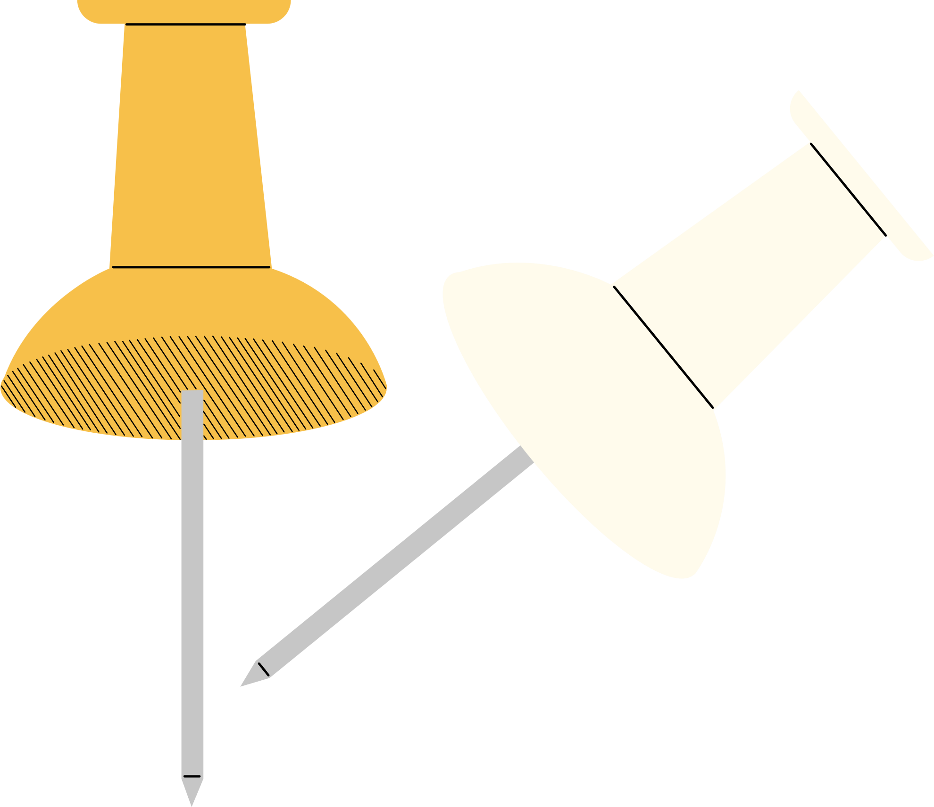
TIME FOR QUESTIONS!
Please unmute yourselves or type your questions into the chat box.
Notes:
RAYMUNDO
Please unmute yourselves or type your questions into the chat box.

Slide 26
LET'S PUT IT IN ACTION!
UNITY
DEMONSTRATION
Notes:
JESSICA
***If there's no time for the demonstration, direct to the LMS course***
Now, let's put all of this in action. We're going to share our screens and show you what it looks like to complete a home evaluation in UNITY.
If you are not a UNITY user, you are welcome to leave at this time.
Remember, to receive credit for your attendance, you must complete the training feedback survey.
The link is located in the chat box! Thank you for joining us!

Slide 27
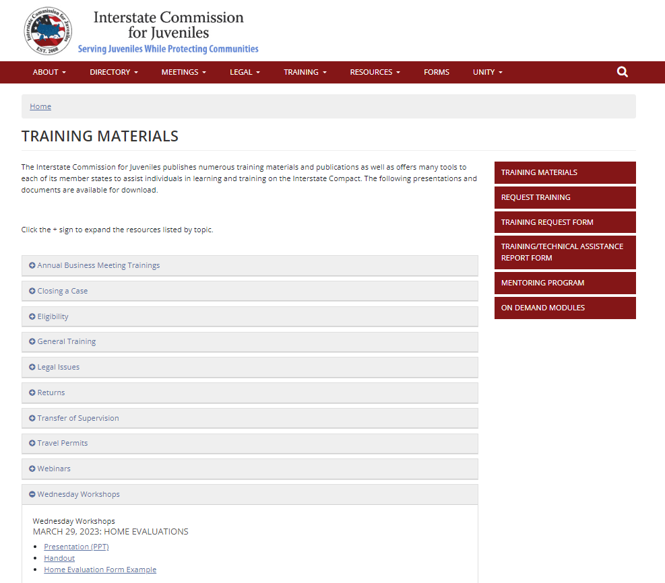
TRAINING MATERIALS
Notes:
AMANEE
If you would like to download a copy of this presentation, handout, and sample form for in-state trainings, visit the "Training Materials" page on the Commission's website.

Slide 28
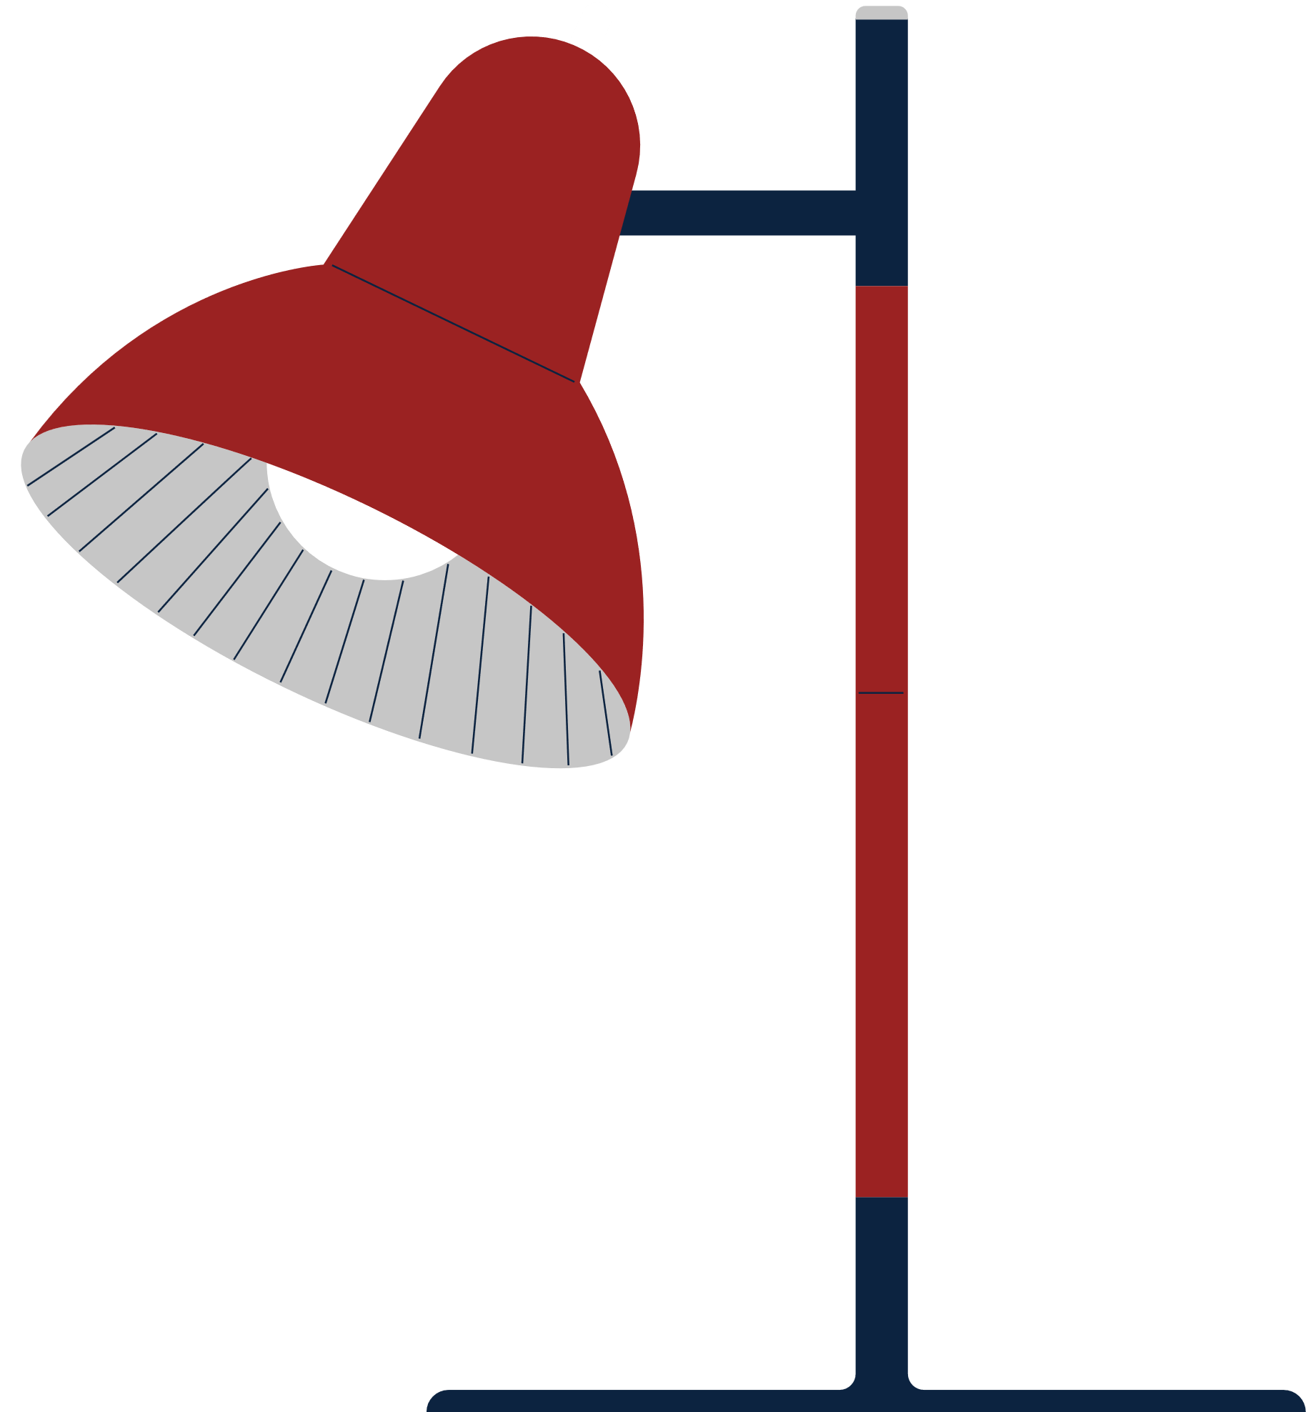
Additional Training Resources
"ICJ in Action" courses on ICJ.TalentLMS.com
ICJ Bench Book for Judges and Court Personnel
ICJ Rules
Notes:
AMANEE

Slide 29
WEBSITE RESOURCES
Notes:
AMANEE
Speaking of website resources, we encourage you to download and distribute the new "Website Resources" document.
This document was created to help viewers understand the range of resources available.
There are four categories:
- Training
- Legal
- Quick Reference Guides
- and Matrices
It can be printed for trainings or distributed electronically, which is nice because it has embedded links.
You can access this content via the new ICJ Website Resources webpage - Located under the resources tab.

Slide 30
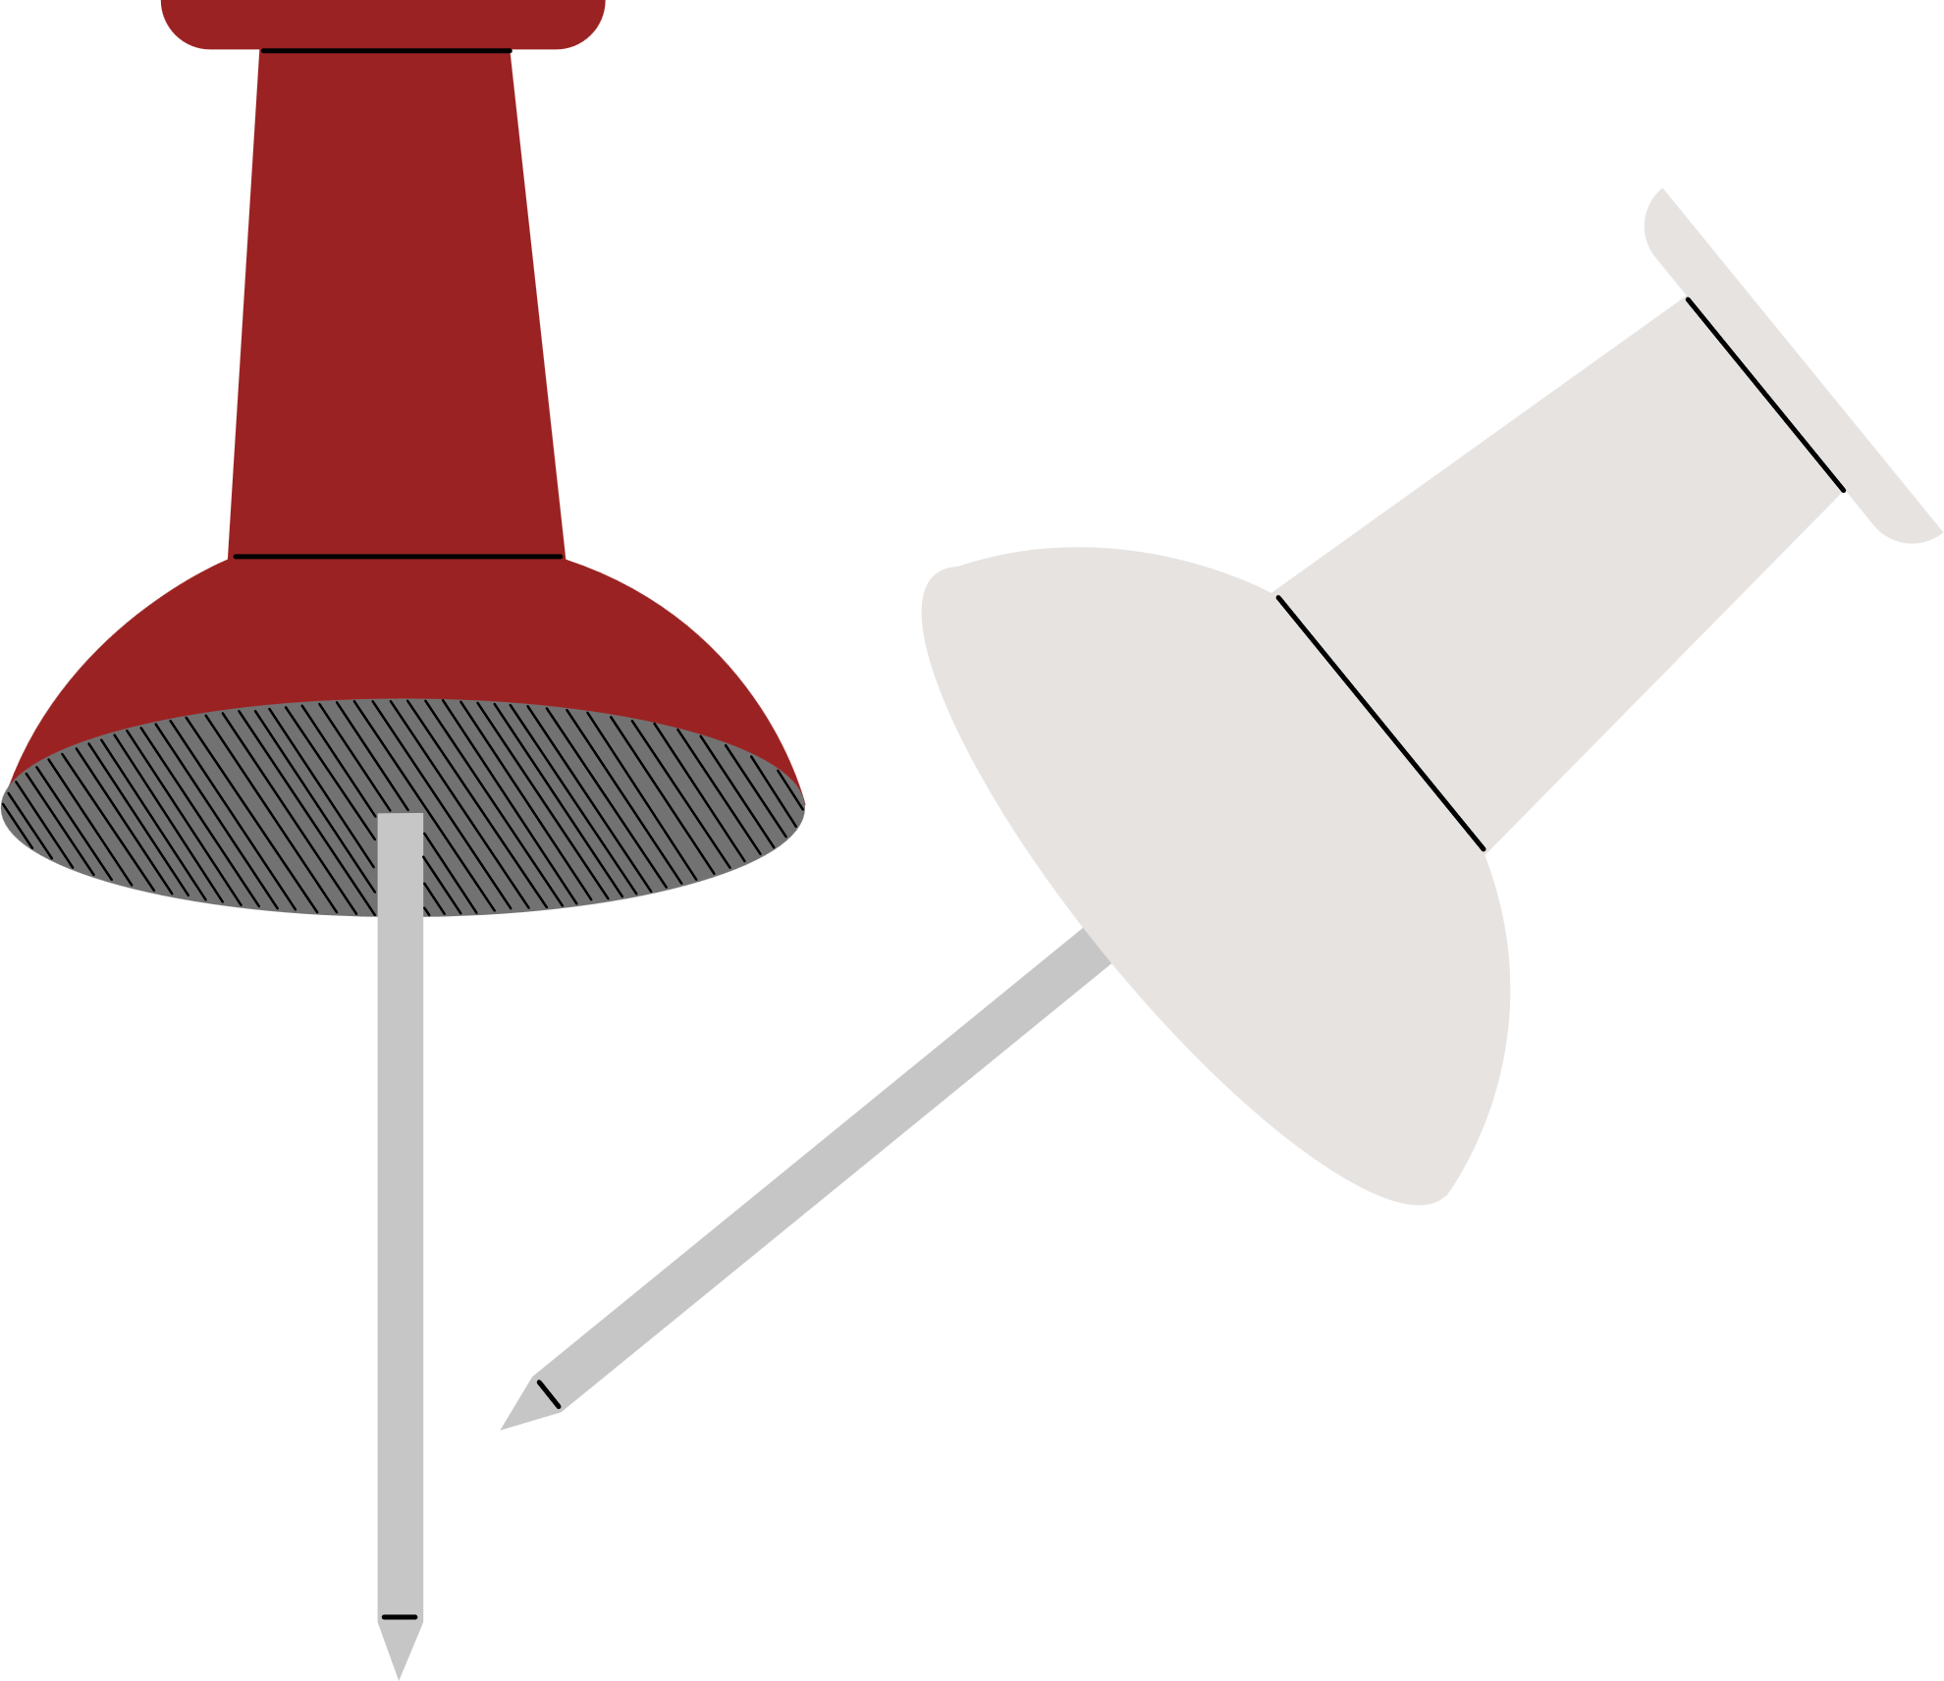
UPCOMING TRAINING SESSIONS
TODAY - MAY 31: UNITY Enhancements (2:30 PM ET)
June 28 and July 26: UNITY Enhancements (1:00 PM ET)
Notes:
CORRIE
Our next few months of live training sessions will focus on the upcoming UNITY Enhancements.
Beginning with the first training, TODAY at 2:30 pm ET! The Zoom link is located on the Commission's calendar and in the chat!
In June and July, the sessions will be presented on the last Wednesday of each month from 1:00-2:00 pm ET.
You can access those Zoom links via the Commission Calendar.
As always, if you are unable to attend, the sessions will be recorded and posted on the LMS.
Thank you for joining us and we look forward to seeing you next time!

