Slide 1
Rules Round-Table Discussion:
JIDS Impact
2013 Annual Business Meeting

Slide 2
Rule 1-101: Adjudicated Status Offender
No JIDS Impact

Slide 3
Rule 1-101: Aftercare (temporary community placement)
No JIDS Impact

Slide 4
Rule 1-101: Custody
No JIDS Impact

Slide 5
Rule 1-101: Home Evaluation/ Investigation
No JIDS Impact

Slide 6
Rule 1-101: Juvenile Sex Offender
No JIDS Impact

Slide 7
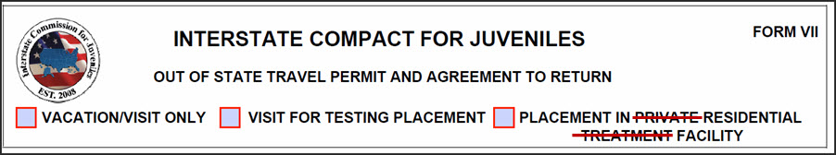
Rule 1-101: Residential Facility
Strike the words “private” and “treatment” on Form VII
Cost estimate = $150

Slide 8
Rule 1-101: Sanction
No JIDS Impact

Slide 9
Rule 2-102: Data Collection
No JIDS Impact

Slide 10
Rule 4-101: Processing Referrals
No JIDS Impact

Slide 11
Rule 4-101A: Transfer of Students
No JIDS Impact

Slide 12
Rule 4-102: Sending and Receiving Referrals
No JIDS Impact

Slide 13
Rule 4-103: Transfer of Supervision Procedures for Juvenile Sex Offenders
No JIDS Impact

Slide 14
Rule 4-104: Supervision/Services Requirements
No JIDS Impact

Slide 15
Rule 5-102: Travel Permit (Rules Cmte)
Strike the words “private” and “treatment” on Form VII
Cost estimate = $150
Same JIDS and fiscal impact as Rule 1-101: Residential Facilities

Slide 16
Rule 5-102: Travel Permit (West Region)
No JIDS Impact

Slide 17
Rule 6-103: Non-Voluntary Return of
Out-of-State Juveniles
No JIDS Impact

Slide 18
New Rule 6-103A: Non-Voluntary Return of an Escapee, Absconder or Accused Delinquent
No JIDS Impact

Slide 19
Rule 6-104: Return of Juveniles Whose ICJ Placement Has Failed
See JIDS Impact for
new violations rule

Slide 20
Rule 6-106: Public Safety
No JIDS Impact

Slide 21
Rule 7-101: Adoption of Rules and Amendments
No JIDS Impact

Slide 22
New Rule: ICPC Recognition
No JIDS Impact

Slide 23
New Rule: Reporting Juvenile Non-Compliance, Failed Placement and Retaking
Add/modify fields to Form IX
New escalation email in “Violation Report and Reply” workflow
Cost estimate = $600

Slide 24
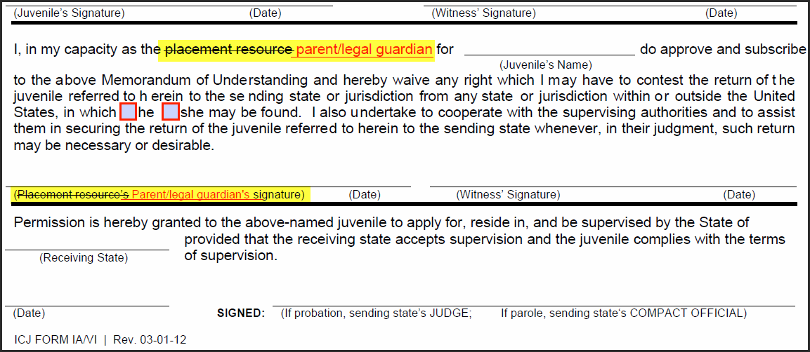
Form IA/VI: Application for Services and Waiver
Replace “placement resource” with “parent/legal guardian”
Cost estimate = $150

Slide 25
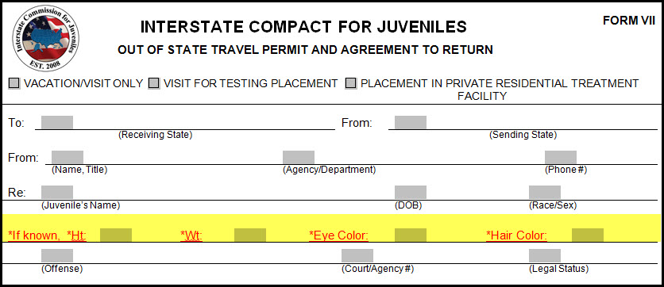
Form VII: Travel Permit (West Region)
Add 4 fields: Height, Weight, Eye Color, and Hair Color
Cost estimate = $300

Slide 26
Form XI: Absconder from Supervision Violation Report
Delete Form XI
Add 4 fields to Form IX
2 report changes
Cost estimate = $1,200

Slide 27
Reorganization

Slide 28
Region Meetings
3:30 – 5:00
Region | Room
East | Cavetto
Midwest | Colonnade
South | Abbey North
West | Dolores

