Slide 1
Interstate Compact for Juveniles State Council Training
Updated January 2018

Slide 2
Overview
This training will cover:
The reasons for forming a state council
The required membership of a state council
Duties of individual state council members
The rulemaking process of the Commission

Slide 3
Introduction and History
Original compact enacted in 1955
Revised compact enacted in 2008
Ensures effective monitoring of juvenile offenders moving across state lines
Provides for the welfare and protection of juveniles and the public
Serves as the only legal process for returning runaways

Slide 4
Advantages of the New Compact
Provides enhanced:
Accountability
Enforcement
Visibility
Communication
Resolves discrepancies between state laws

Slide 5
Purpose of the ICJ
Promote public safety
Protect rights of victims
Control movement of juveniles
Provide for effective tracking
Supervision
Rehabilitation

Slide 6
National Structure
National Commission
Chair
Vice Chair
Immediate Past Chair
Executive Committee
Treasurer
Secretary (Executive Director)
National Office
Committees
Regions

Slide 7
Role of the State Council
Provide mechanism for empowerment of Compact process
Assist in developing Compact policy
Determine qualifications for membership on Council
Appoint designee when Commissioner is unable to attend

Slide 8
Why is it necessary to have State Councils?
State Councils address three problems:
The Interstate Commission for Juveniles may be unknown outside the agency where the Commissioner works
Interstate compliance is not exclusively an issue for one state agency
Interstate supervision is a significant policy concern

Slide 9
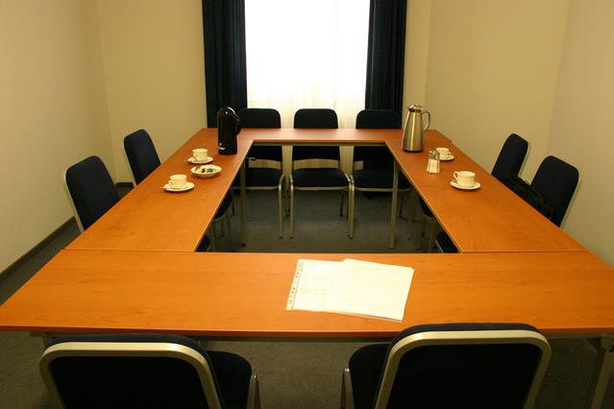
Empowerment
Each state is required by statute to establish a State Council for overseeing its intrastate affairs dealing with the Compact
An active State Council can have a positive influence on a state’s Compact operations
State Councils can serve as an advocate when seeking resources, improving operations, resolving disputes and conducting training

Slide 10
Membership
States determine the structure, composition and budget of its State Council
Must include: at least one representative from the legislative, executive and judicial branches of government, victim groups, other community interest groups, and the Compact Administrator, Deputy or Designee
State Council
Governor Representative
Legislative Representative
Judicial Representative
Victim’s Advocate
Commissioner

Slide 11
State Council Appointments
Factors to consider when recommending appointments include:
Is the candidate willing to serve on the Council?
Does the candidate have a demonstrated interest in the Compact process?
Is the individual well known in the juvenile justice community?
Is the candidate influential?

Slide 12
State Council Members should be…
Familiar with the Compact and its purpose
Educated on your state’s Compact process
Familiar with how your state appoints the Compact Administrator and Commissioner
Familiar with the authority vested in the Interstate Commission
Familiar with the process if the Commissioner cannot attend a Commission meeting

Slide 13
State Council Members should…
Assist in determining if the ICJ Office has adequate staff for the operation of the Compact
Become familiar with the Rules of the Compact and discuss any desired additions or amendments
Assist the Commissioner in developing a network within your state to assist with the Compact process
Discuss the addition of other members that may lend assistance to the Compact Process
Serve as an advocate for ICJ

Slide 14
Preliminary Activities for the Council
Develop the Council’s:
Mission Statement
Short and long term plans
Establish Meeting Procedures:
Scheduling
Notices
Meeting minutes
Voting procedures
By-laws
Goals and objectives

Slide 15
Staying Energized
Projects that are helpful to the ICJ Office and suitable for engaging the Council include:
Developing a dispute resolution policy and procedure
Assessing ICJ Office workloads and needs
Recommending changes in ICJ Office business process and procedures
Recommending changes to the ICJ Rules

Slide 16
State Council Enforcement Policy
By January 1 of each year, member states and territories shall submit the following information regarding their State Council to the National Office:
State Council membership roster
Meeting dates from previous year

Slide 17
Proposing New Rule Changes
Commission rules must be adopted in a manner that is substantially similar to the process of the Administrative Procedures Act.
Once adopted, the rules have the force and effect of statutory law and supersede any inconsistent state laws
Majority of state legislatures can reject a proposed rule
Notes:
Any ICJ Compact Commissioner or Designee may submit proposed rules or amendments for referral to the Rules Committee during the annual meeting of the Commission. Rule proposals shall be drafted not later than the next annual meeting falling in an odd-numbered year. This proposal would be made in the form of a motion and would have to be approved by a majority vote of a quorum of the Commission members present at the meeting.
See Section 200, Rule 2-103

Slide 18
ICJ Website
Forms (PDF)
By-laws
Manuals
Advisory Opinions
Legal Memorandums
Rules (PDF & step-by-step)
Presentations
Compact Office Directory
Meeting Announcements
JIDS Helpdesk and FAQ
Matrices
Toolkit for Judges

Slide 19
To Learn More…
On Demand Training Courses
Introduction to ICJ Rules and Eligibility for Compact Services
Transfer of Supervision
Supervision in the Receiving State
Returning Juveniles
Travel Permits
Legal Significance of the ICJ
New Commissioner/Designee

Slide 20
Contact Information
National Office
Interstate Commission for Juveniles
836 Euclid Avenue
Suite 322
Lexington, KY 40502
(859) 721-1062
www.juvenilecompact.org

