Slide 1
UNITY Transition Planning Session
Model 2 Discussion
This session will begin soon. Please mute yourself.
Thursday, January 14, 2021
2:00 pm

Slide 2
UNITY Transition Planning Session
Model 2 Discussion
Welcome
Anne Connor
Technology Committee Chair
Notes:
Welcome to the Model 2 UNITY Transition Discussion Session. We hope you were able to join us for the session on Tuesday that covered material applicable to all states. If not, that session was recorded and will be made available at a later date.
Let’s cover a few housekeeping items. Today’s session is scheduled for 1 hour. Please mute yourself if you’re not talking to cut down on background noise, but feel free unmute yourself if you have a question or comment. There will be opportunities for questions and discussion throughout, but please also feel free to use the chat box at any time. The chat box is located in the bottom right side of the screen.
This session is being recorded and will be made available at a later date.

Slide 3
UNITY Transition Planning Session
Model 2 Discussion
Presenters
Rachel Johnson, Compact Office – North Carolina
Holly Kassube, DCA – Illinois Probation
Notes:
Today’s presenter is Rachel Johnson from the North Carolina compact office. Holly Kassube Deputy Compact Administrator for Illinois Probation is also on the call to help answer questions.

Slide 4
Model 2 Discussion
ICJ Forms
Data Entry & Document Management
Your State’s Policies and Procedures
In-state Training
Notes:
The topics covered today include ICJ Forms, Data Entry & Document Management, your state’s policies and procedures and in-state training. I’ll turn it over to Rachel Johnson to get us started today.

Slide 5
Model 2 Discussion
ICJ Forms
Data Entry & Document Management
Your State’s Policies and Procedures
In-state Training
Notes:
We’d like to start today’s session with a discussion of ICJ Forms.
When UNITY goes live, ICJ Forms versions will change to accommodate updates for consistency. These will be built into UNITY. Remember also that the Form IA/VI will be the Form VI, and the Form IX will be split into three forms for the QPR, Absconder, and Violation Reports.
It will be very important to ensure your state is using the updated version of ICJ Forms because of the way the updated forms correspond with UNITY data fields. The National Office will provide PDF versions to compact offices in January and they will be available on the Commission’s website when UNITY goes live.
Question: What’s your plan to ensure all stakeholders are aware of ICJ Form version updates and are not using old versions of ICJ Forms?

Slide 6
Data Fields Not on ICJ Forms
Notes:
Additionally, with the new system, there are a few required fields that must be entered but don’t appear on any of the ICJ forms. For example, UNITY requires legal guardian information for a Transfer of Supervision case. If the youth will be living with someone other than their legal guardian in the receiving state, that information is not on any ICJ Form but is required for the case.
Question: How do we ensure field staff are providing that information? Does a supplemental information sheet need to be created for them to complete?

Slide 7
Model 2 Discussion
Q & A

Slide 8
Model 1 Discussion
ICJ Forms
Data Entry & Document Management
Your State’s Policies and Procedures
In-state Training
Notes:
For Model 2 states, the JPS/Zone Supervisor role will be adding form data into UNITY data fields. Have you communicated to your UNITY users that data must be entered into UNITY instead of only uploading scanned forms? Depending on how things are currently done in your state, this may require more time the prepare cases than they are used to.

Slide 9
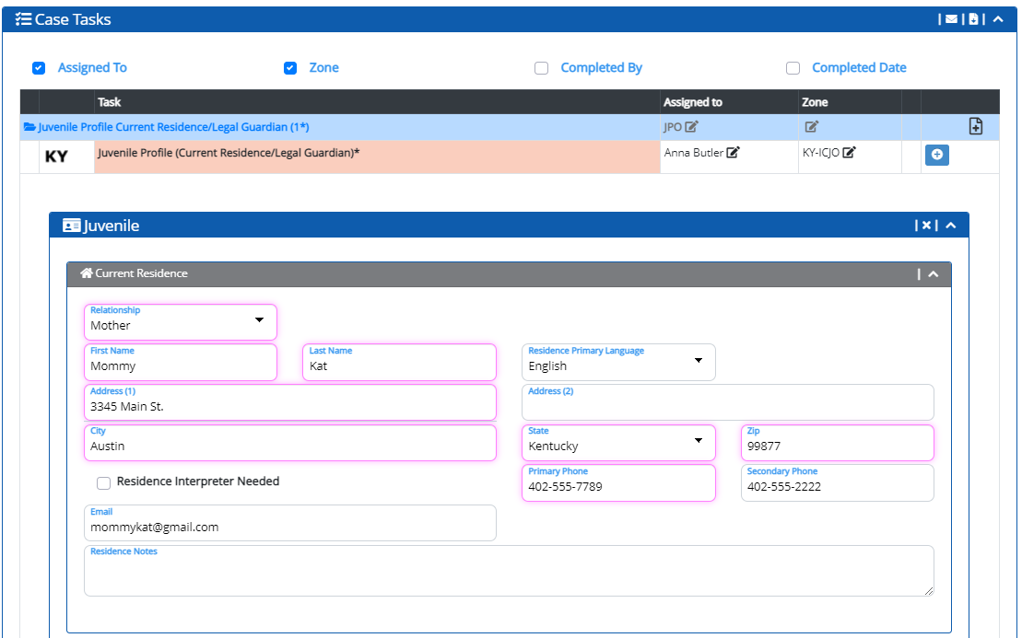
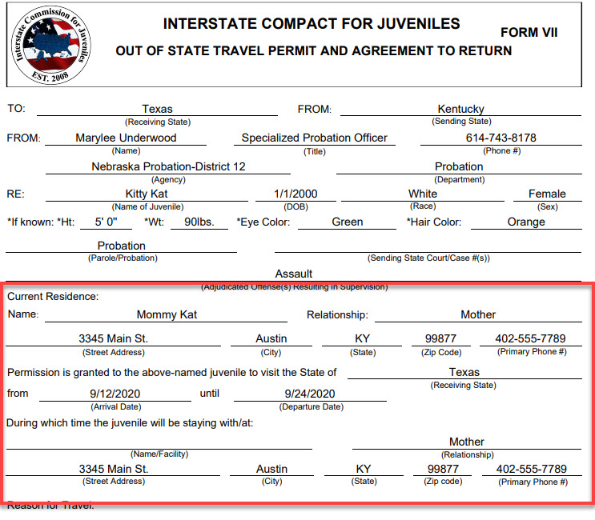
Data Entry
Notes:
JIDS had a handful of data fields on the File Details page and also the e-form fields. Much of the time, users put “see scan” in the required e-form fields and uploaded scanned documents. However, UNITY relies upon data fields in order to populate ICJ Forms so this practice won’t work for UNITY. Users can generate ICJ Forms after the data are entered and print off forms to obtain signatures, when required.

Slide 10
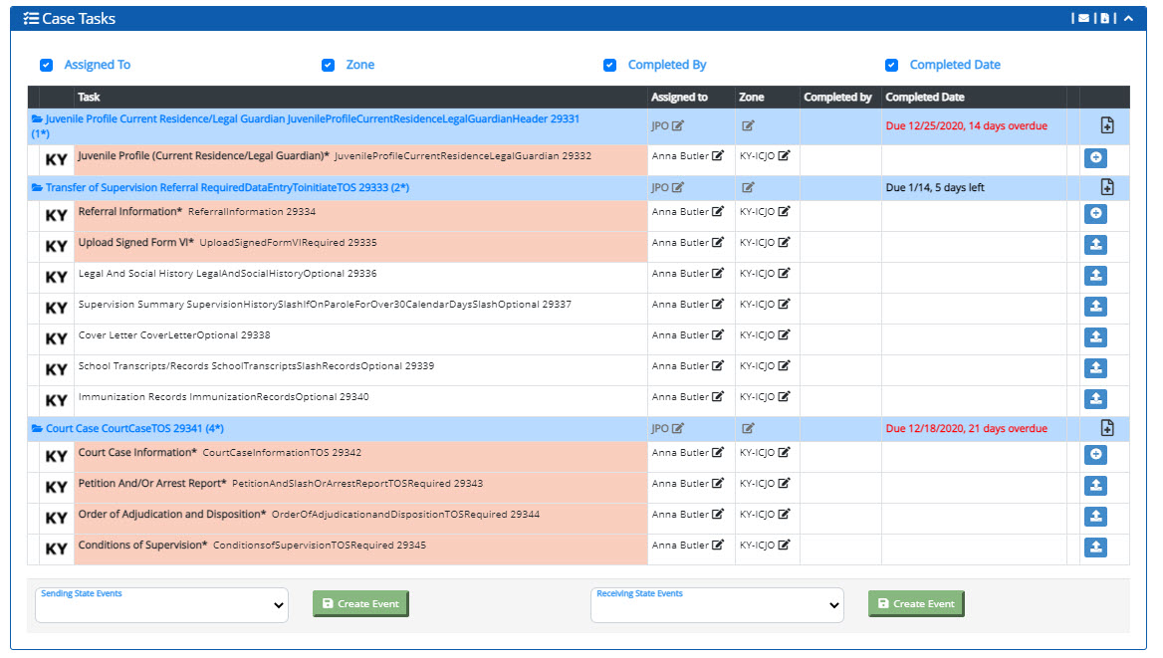
Document Management
Notes:
In the session on Tuesday, we discussed that UNITY will require uploading documents separately, according to the case task list. Is your state’s practice currently to scan all supervision documents to one file? Will that present a problem for the person entering documents into UNITY? The free version of Adobe Reader CAN be used to separate documents by using the print function, selecting print to PDF as the Printer, and then selecting the document page number or numbers to be separated into a new PDF. However, combining documents into one PDF for sending items out cannot be done using Adobe Reader. If you have Adobe Acrobat you can combine documents. It may be that the people receiving the documents will now get them separately. Additionally, it will be best practice to name documents in a uniform fashion that makes it easy to determine what the document is.
Also, since your Zone Supervisors will be entering data and documents that they receive from field officers, consider how the field officer will know what information to provide. Do you already utilize some type of checklist or does one need to be developed in order for field staff to know exactly what they need to provide for entry into UNITY?
Decide what will work best for your state and ensure that your field users and supervisors know what information is required and how to get it to the designated UNITY user. As discussed in the policy and procedures section, this may require a considerable change to current practice and a training plan.

Slide 11
Model 2 Discussion
Q & A

Slide 12
Model 2 Discussion
ICJ Forms
Data Entry & Document Management
Your State’s Policies and Procedures
In-state Training
Notes:
Next, we’ll discuss policies and procedures. Do any of your state’s policies require review? Are there any procedures or practices that worked for JIDS but will need to be adapted for UNITY?
For example, UNITY requires entering specific documents in the Transfer of Supervision case Task List, rather than uploading a combined packet. Will this affect how your field users interact with the data system or how the compact office receives information? If your field users are used to scanning in one large packet, they’ll need to understand that the system will be looking for the presence of certain documents in certain locations.
Question: If you have identified policies or procedures that need to change, what is your state’s plan to revise policies and educate stakeholders about changes?

Slide 13
Model 2 Discussion
Q & A

Slide 14
Model 2 Discussion
ICJ Forms
Data Entry & Document Management
Your State’s Policies and Procedures
In-state Training
Notes:
What is your state’s plan to onboard new UNITY users? When Joe requested the personnel list, he also imported those users into the Talent LMS system, which is the hub for all Rules and UNITY training.

Slide 15
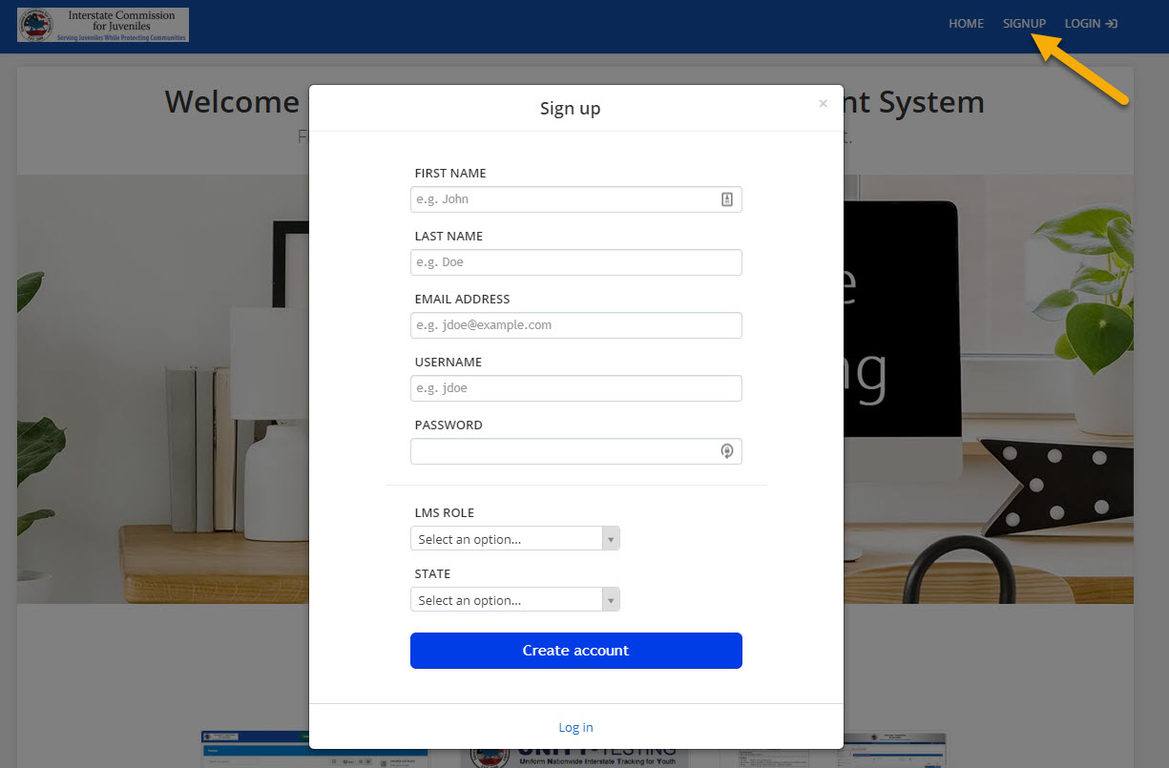
https://icj.talentlms.com
Notes:
If someone in your state needs a Talent LMS account but doesn’t yet have one, submit their information using the Smartsheet and the national office will import them on a weekly basis. Other people, such as judges, can self-enroll from the login page.
Your state may wish to do its own UNITY training in conjunction with the Talent LMS modules.
Question: Do you have a plan in place? And how will you communicate that plan to your states users?

Slide 16
Model 2 Discussion
Q & A

Slide 17
UNITY Transition Planning Session
What is your plan/strategy to communicate changes/updates to all field staff?
Notes:
In conclusion, we hope this session provided information to help you prepare for the transition to UNITY. One final question, in light of everything we covered today is: What is your plan/strategy to communicate changes/updates to all field staff?
As you consider that question, remember that we have our Wednesday at 1 sessions with Joe where we can all bounce ideas of each other. We also encourage you to reach out and talk to other Model 2 states.
Thank everyone for attending today’s session. If you have questions that didn’t get answered, please submit them using the UNITY Rollout & Training Questions form that is available on the Commission’s website, on the UNITY page, so they can be addressed in the Wednesday UNITY Coordinator meeting agenda.

Slide 18
UNITY Transition Planning Session
Thank You For Attending

